Slide 1
Smart Moves for Sixth Form College is an interactive and easy to use resource to help build life long resilience skills.
Our capacity to cope with the things that life throws up is a key factor in determining our wellbeing and mental health.
Smart Moves are small learnable skills that increase resilience.
You can go through the steps in any order and you will have a positive impact on your resilience.
Smart Moves is based on the Resilience Framework, devised by Professor Angie Hart and collaborators at the University of Brighton and boingboing

Slide 2
Problems will arise in life for all of us– it’s part of life. Everyone faces challenges, in fact that’s normal.
Many of the challenges that you are experiencing are normal. You are not alone. Most us carry anxieties and vulnerabilities.
Many experience distress at life events, loss, change, relationship issues, self doubt.
We cannot predict nor prevent everything that may happen in your life but we can equip you with tools so that you are prepared and able to cope better with whatever comes along.
Notes:
Ask them:
Raise your hand if you have ever faced a challenging time or a problem in life (you won’t ask them to share this!) Most people will raise their hands.
Say Problems will arise in life for all of us– it’s part of life. Everyone faces challenges, in fact that’s normal. Often young people are not explicitly told that problems are normal and if they are facing a tough time it’s not anything unusual.
Sometimes as adults we not always explicit in helping YP see that some of the challenges that they are experiencing are normal and that many young people go through what they are going through. They are not alone. Most us carry anxieties and vulnerabilities.
Many experience distress at life events, loss, change, relationship issues, self doubt. We know that as adults many of us will at some point in our lives suffer with some form of mental health problem or at the least mental distress of some kind.
We cannot predict nor prevent everything that may happen to a child but we can equip them with tools so that they are prepared and able to cope better with whatever comes along.

Slide 3
What is resilience? Why does it matter?

Slide 4
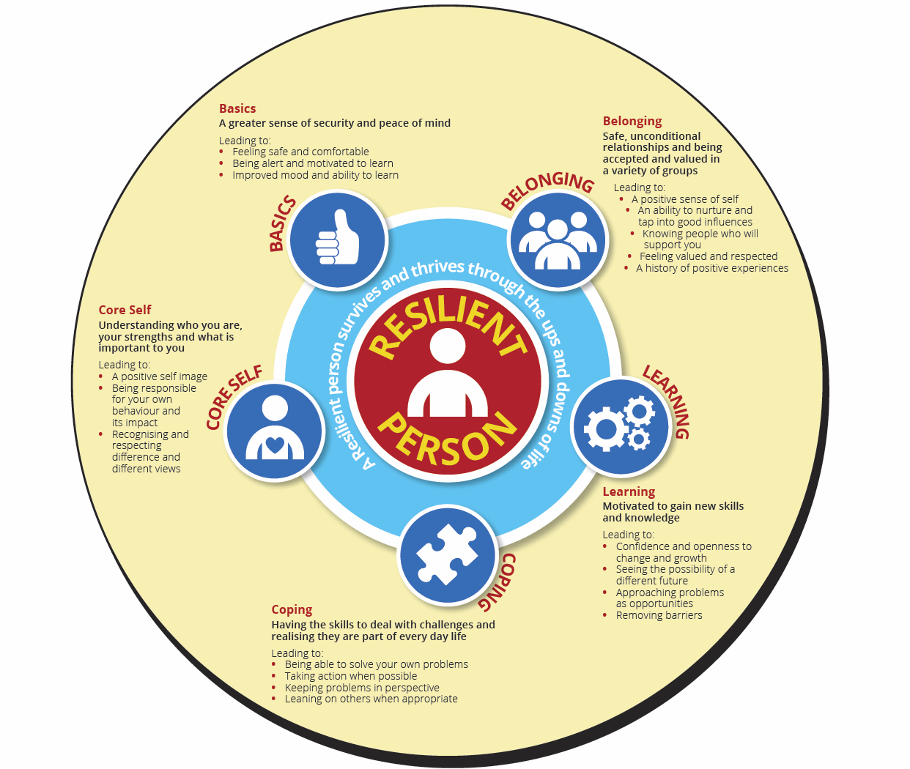

Slide 5
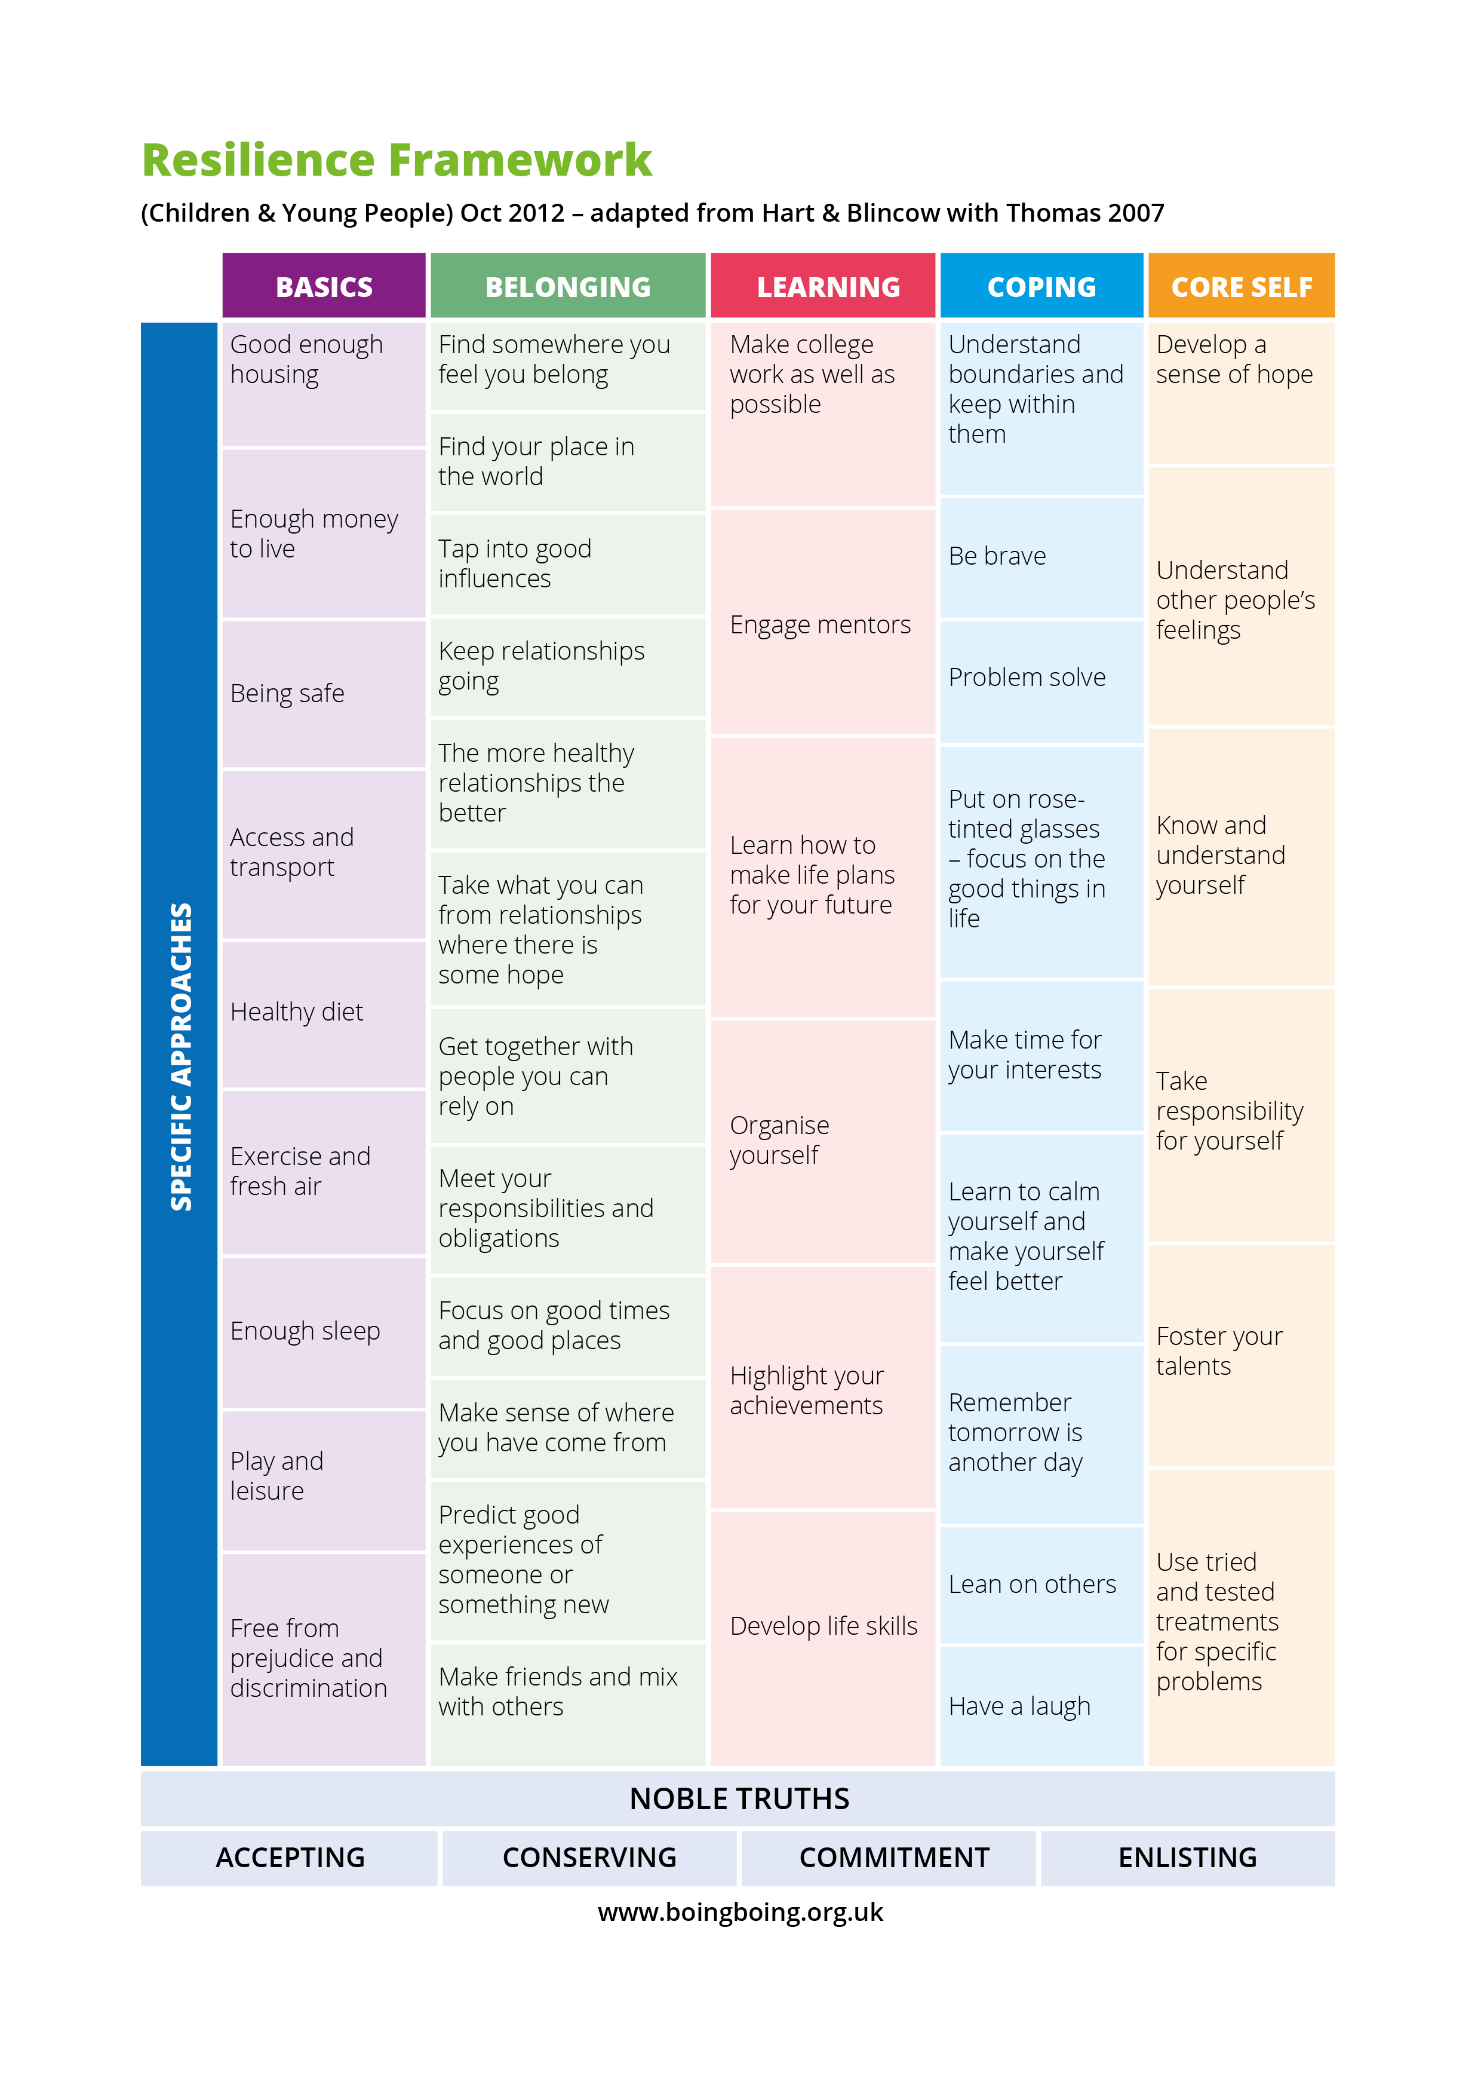

Slide 6
What strikes you about the Framework?
What areas of the Framework do you find most useful?
Find your strengths - which ones are you strong at – aim to find 5!
Develop more skills - which ones do you find the most challenging ? (find 5).
Now you can dive into the Smart Thinking, Smart Questions and Smart Moves on the areas you want to develop more skills in.

Slide 7
ACCEPTING - Start where you are. Concentrate on what can happen rather than getting caught up in what is not working.
CONSERVING - Notice the good things happening in your life and build on what is already in place.
COMMITMENT - Learning resilience is rarely a quick fix. Be committed.
ENLISTING - Enlist others expertise and resources.
Who else can you enlist to support you?
Approaches
that support
Resilience

