Slide 1
Smart Moves for Sixth Form College is an interactive and easy to use resource to help build life long resilience skills.
Our capacity to cope with the things that life throws up is a key factor in determining our wellbeing and mental health.
Smart Moves are small learnable skills that increase resilience. You can go through the steps in any order and you will have a positive impact on your resilience.
Smart Moves is based on the Resilience Framework, devised by Professor Angie Hart and collaborators at the University of Brighton and boingboing
Notes:
2015 The Department Of Health in conjunction with NHS England issued a paper entitled Future in mind - Promoting, protecting and improving our children and young people’s mental health and wellbeing. Following the findings in this report, there has been a focus on resilience – helping young people acquire the skills they need when life throws up challenges.
Research evidence shows that education and health are closely linked and that promoting the health and wellbeing of pupils and students within schools and colleges has the potential to improve their educational outcomes and their health and wellbeing outcomes.

Slide 2
Notes:
Challenges are a normal part of life. Hands up here who has faced a challenge of some kind in their lives! So we need to equip young people with skills to cope with what life throws up.

Slide 3
What is resilience? Why does it matter?
Notes:
Group exercise:
In pairs/on your tables discus the questions ‘what is resilience? And why does it matter?’ (PPT slide 3) (3-5mins to discuss)
Ask them to feedback one or two answers from each table, thank each person for their contribution.
Typical answers include:
Coping with change
Coping with challenge
Bouncing back
Mention the following Boingboing (where the material comes from) use the phrase ‘Bounce forward’ rather than bounce back. As you move forward each time you overcome something. Next time you have a similar situation you will cope slightly better because you faced it and overcame it before.

Slide 4
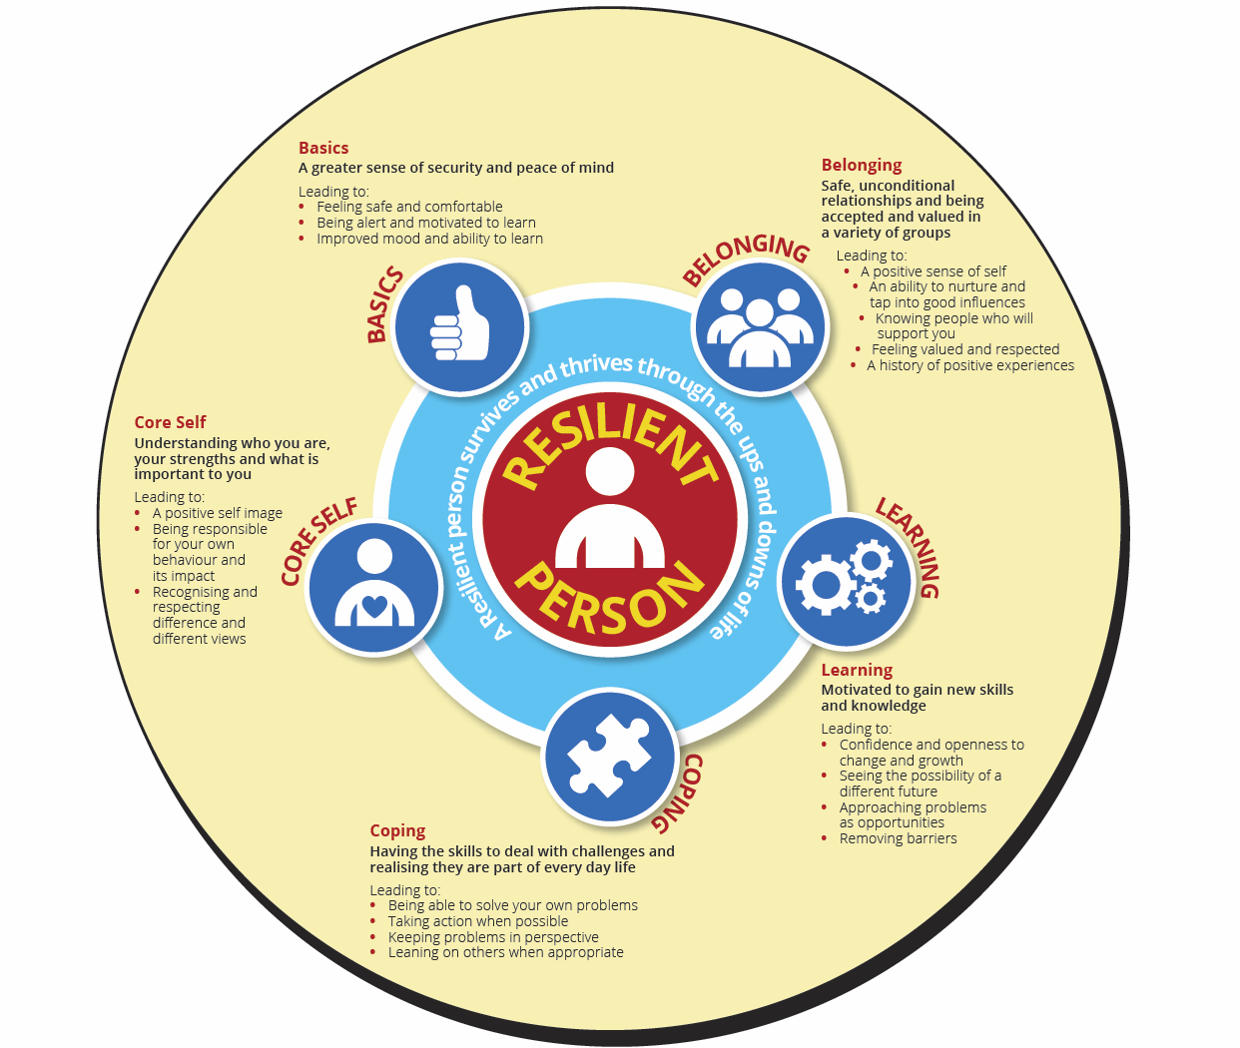

Slide 5
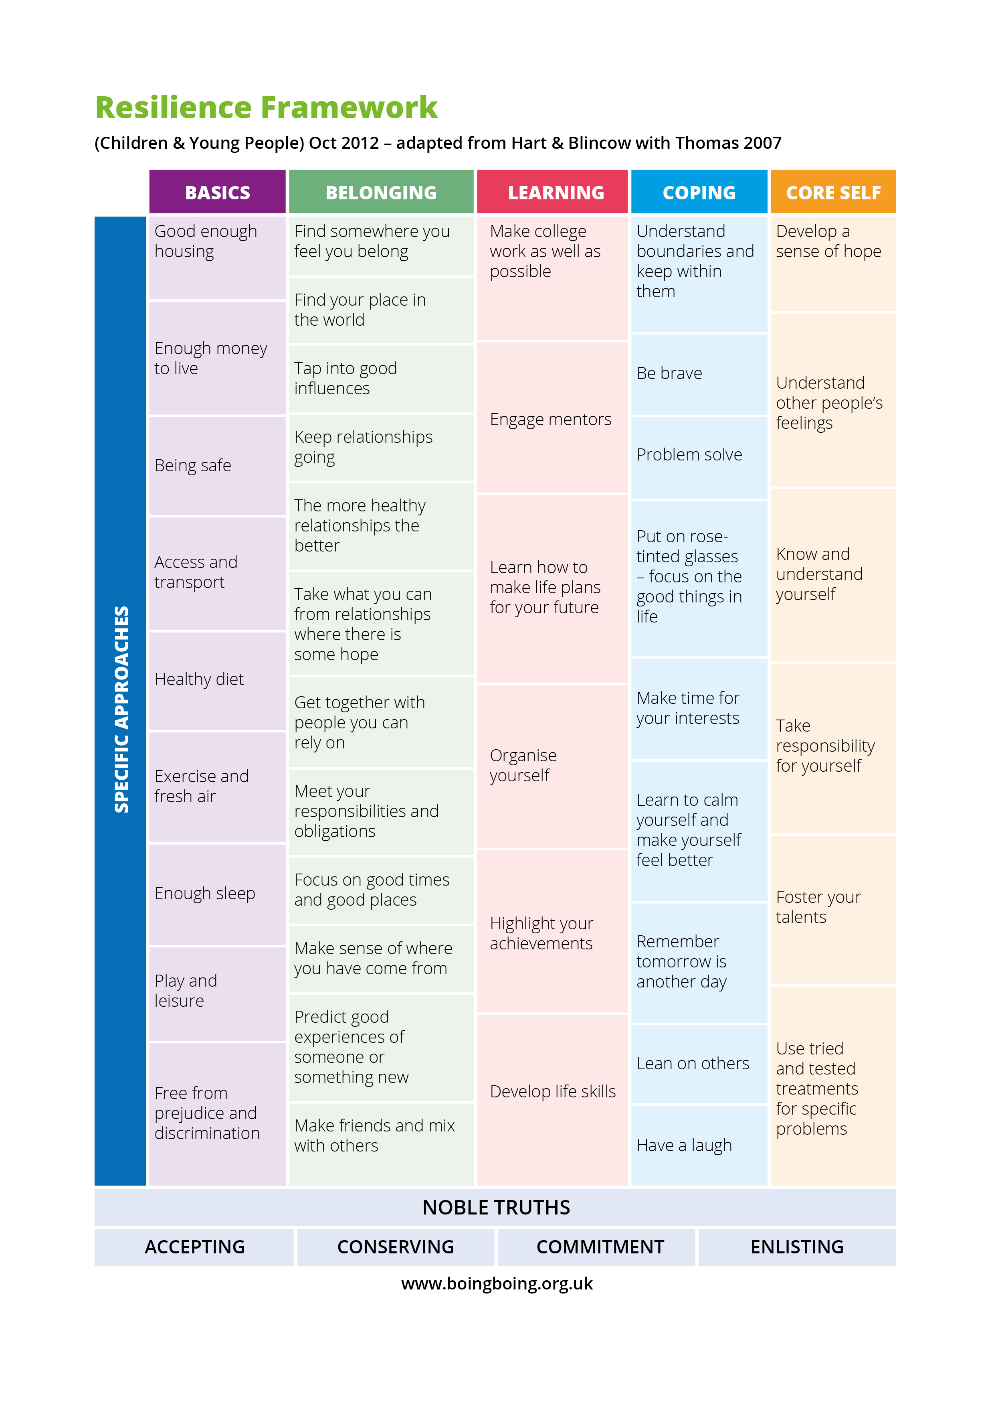
Notes:
Smart Moves is based on the Resilience Framework devised by Professor Angie Hart and collaborators at the University of Brighton and The Resilient Classroom Resource Pack Written by Sam Taylor, Angie Hart And Hove Park School.
The different areas of the Resilience Framework are not designed to be used as a step-by-step guide one after the other, but rather can be called upon when needed and several can be used at the same time. NOT a hierarchy – can learn them out of ‘order’ doesn't matter which you learn
The Resilience Framework breaks down the thing of resilience into Small LEARNABLE skills, practically set out. Hence SMART MOVES
Learnable –you can’t just build resilience, but small moves result in increased resilience
What do we mean by resilience? There are many different definitions of resilience. They define resilience as students achieving good educational outcomes despite adversity.
Resilience is surviving and thriving through the ups and downs of life

Slide 6
What strikes you about the Framework?
What areas of the Framework do you find most useful?
Which parts of the framework are already used as a college and which areas need more focus?

Slide 7
Smart Moves can be used for group sessions or individual.
Staff have many conversations with young people that aim to support them with resilience building – Smart Moves provides a common approach.
Being responsive with the right support can be challenging.
Staff often feel overwhelmed with the need.
Smart Moves is a toolkit that can be used to support students to navigate both individual and universal challenges.
“learning life long resilience skills that can be applied in many different situations.”

Slide 8
Activities can be done as a group or as individuals
Use Smart Questions - ‘ask’ rather then 'tell‘ and work with what students come up with.
Not a lesson – non-didatic
Roll with resistance and focus on what they can change
It is normal for things to go wrong
Keep asking ‘What is another Smart Move’ that you could try?

Slide 9
ACCEPTING - Start where they are. Concentrate on what can happen rather than getting caught up in what is not working.
CONSERVING - Notice the good things happening in pupils lives and build on what is already in place for them.
COMMITMENT - Promoting resilience is rarely a quick fix. Being committed.
ENLISTING - Enlist others expertise and resources.
Who else can you enlist to support the young people?
Approaches
that support
Resilience

